Slide 1
BLUSH

Slide 2
CONCEPT
A nonsensical labyrinth that you must escape while a “day/night cycle” determines what elements of the labyrinth are visible to you. There are 2 states in continuous rotation based on time. The 1st state is represented by a colourful environment and the 2nd state the absence of colour.

Slide 3
GAMEPLAY
Escape the labyrinth (Get from point A to point B). Explore different rooms and search for keys to access new rooms.
Explore the same environment in both colour and not-colour to learn about hidden doors, keys and traps. Fall in traps and die. Get trapped in rooms and be forced to restart. Learn what rooms will kill you and when to navigate certain spaces safely in progressing towards your escape.

Slide 4
MORE GAMEPLAY
What can kill you? Falling in traps; getting trapped in a room.
How to survive? Learn more about the environment through exploration in both colour and non-colour, to gain understanding in how to progress through the map i.e: Learn how to avoid death through exploration.
Mechanics: Restart; Walk; Collect; Use

Slide 5
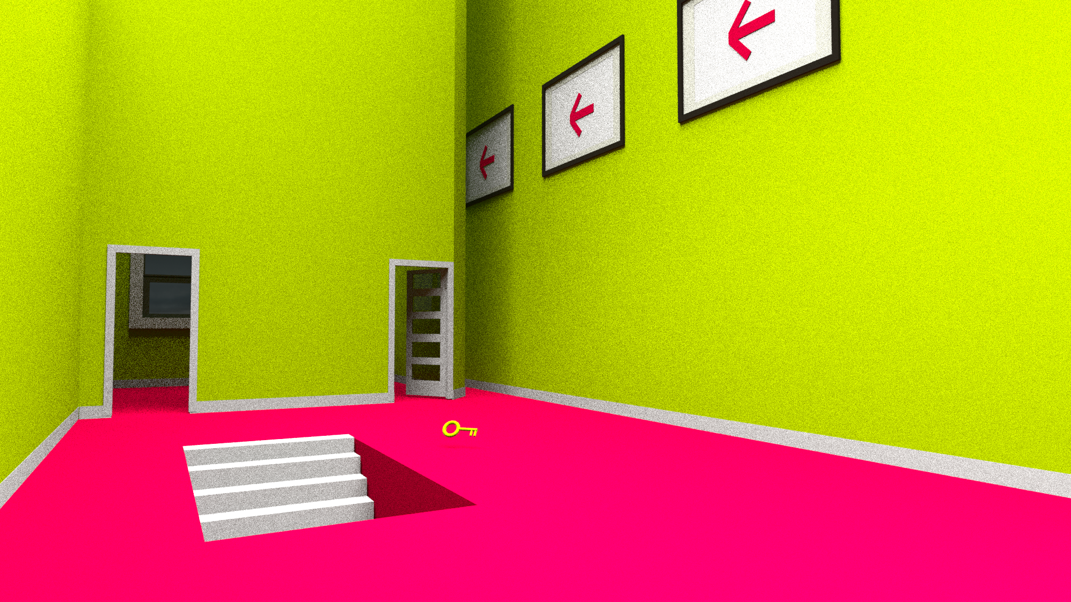
COLOUR
What’s visible?
Stair case
Arrows
Doors
Key

Slide 6
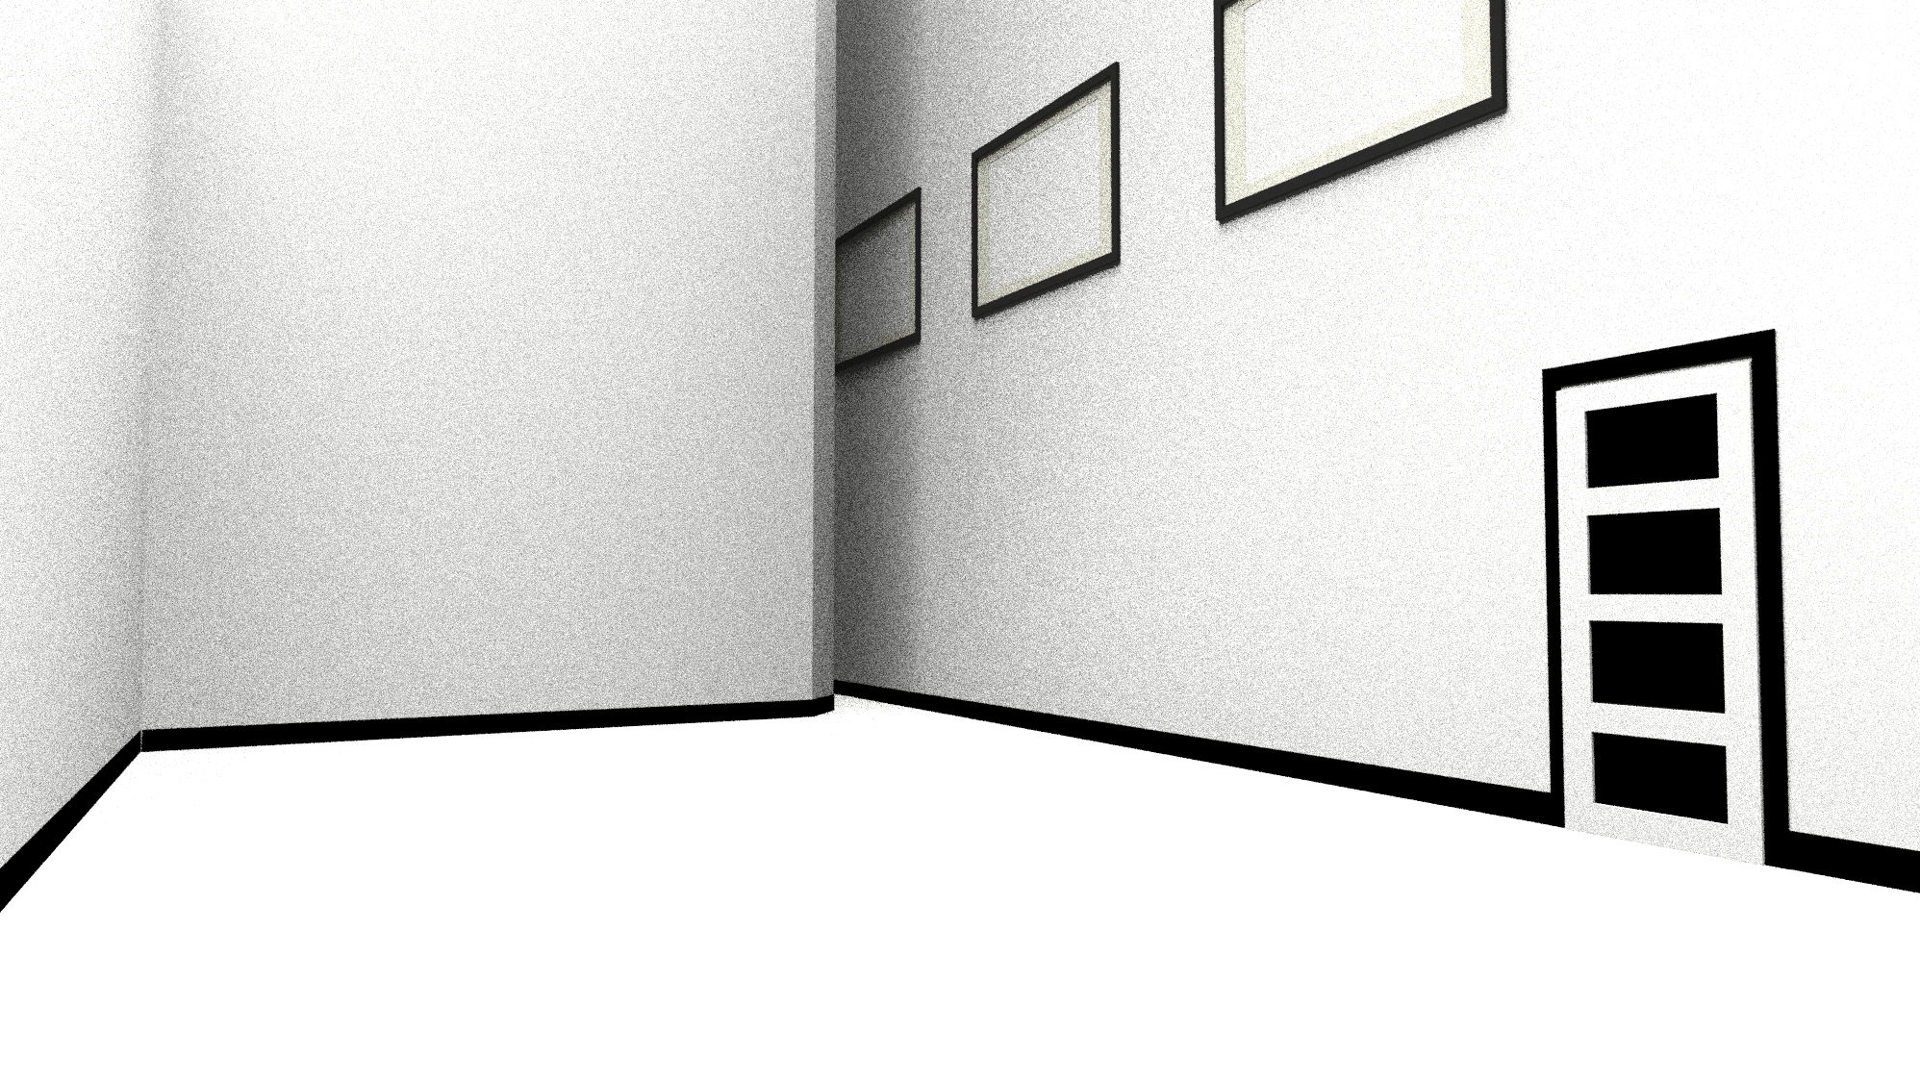
B/W
B / W
What’s visible?
3rd Door

Slide 7
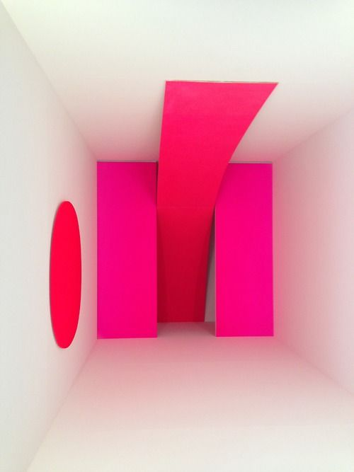


WORLD AND INTERFACE
A network of simply shaped rooms.
Primitive, colour block-ed 3D space.

Slide 8
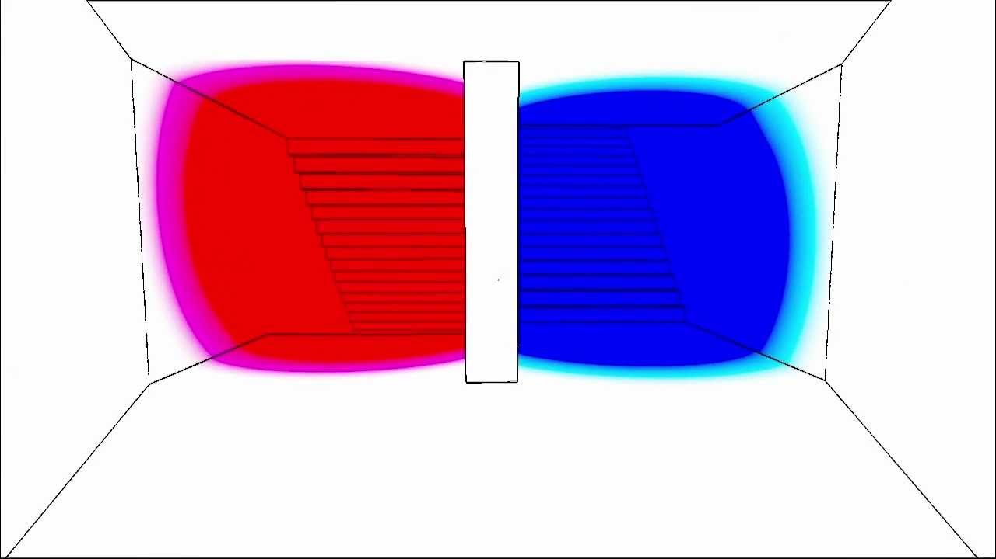
INSPIRATION
Antichamber: Non-discernible objectives; Unclear mechanics; Primitive Environment
Don’t Starve: Day / Night cycle; Survival

Slide 9
FEASIBILITY
Seems within my scope.
Will it be fun? Hopefully
After a ton of consideration I have concluded that certain answers will only present themselves through the making of this game.

